Slide 1
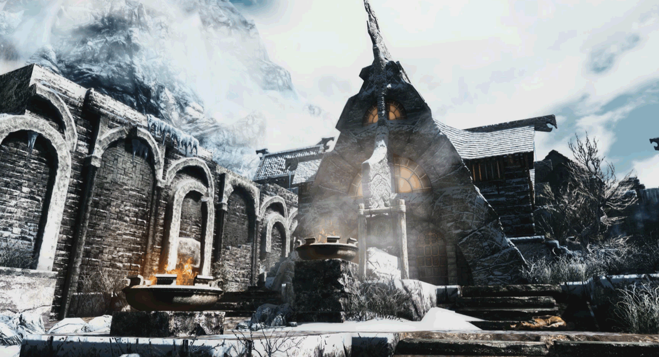
The Cooperative CLassroom
Gamification of the classroom
to increase student ownership of success
John S. Brewer

Slide 2
Students don’t care about what they don’t control
My classroom game is called The Kingdom and The Keys because I hand my students the keys to the car as much as possible.
When you determine the context of your learning you (the student) are always in home court, always driving the bus.
Historically we treat students like passengers on the same bus, with the same destination.
Gamification returns the control and agency to students as much as possible while still hitting our Core Standards.

Slide 3
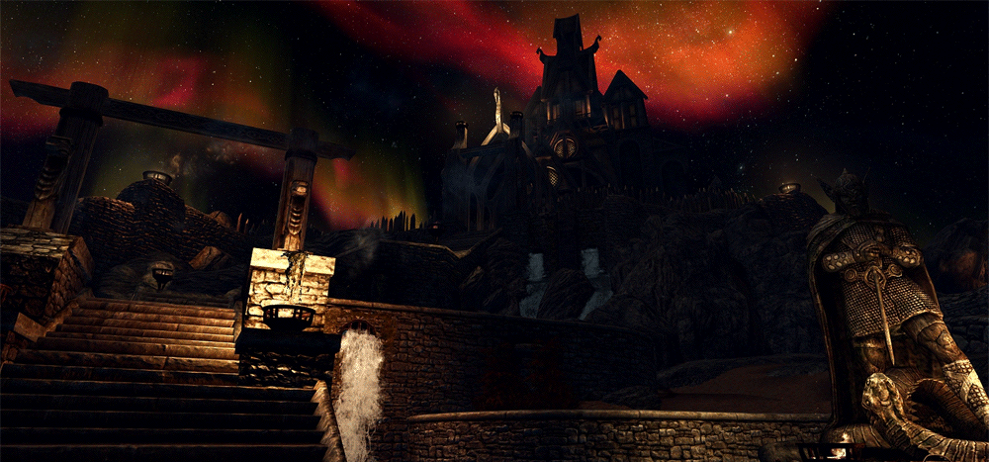
Responding to successful game design with Pedagogy
The best lesson plans in the world… are the tutorial levels in gaming
Key lessons are hidden in a narrative
You must learn key mechanics to advance
As you prove mastery you are awarded with greater control and freedom
The designers of Diablo (Blizzard) are geniuses.
All momentum is forward momentum
No time is wasted
The game rewards players with… new ways to interact with the game.
As educators we need to learn the psychological lessons gaming can teach us.
Our students ALREADY have.

Slide 4
My Progress matters
In a Gamified course you can choose how students engage with a point system
Rather than the grading scale which hasn’t changed in nearly a lifetime
For example,
In my class, students earn “XP” (experience points) based on a variety of English and CC related factors.
The most important aspect of this is that XP can ONLY GO UP.
No backsliding.
No single bad day can wreck your XP
Also,
Your XP gains ALWAYS raise the class average.
ALL of your work, however incremental raises the class average.
YOUR PROGRESS MATTERS TO THE GROUP
Because your group is competing with other groups

Slide 5
Achievement Unlocked Portfolio Complete
In my class specifically,
XP is tied to completing a variety of weekly projects that measure different aspects of Language Arts
These are designed to respond to the multiple modalities as well as different levels of engagement
This perceived freedom of choice increases ownership while producing varied and interesting portfolio pieces, in reality I have designed every student interaction intentionally, as a good game designer.
Students self post their assignments to their digital portfolios, which allows me to assess their writing more holistically, over longer periods of time, and in more depth than the smaller physical portfolios.
Also, with alternative students we see a lot of transfers in and out of our school and having digital portfolios greatly streamlines moving a student’s work.

Slide 6
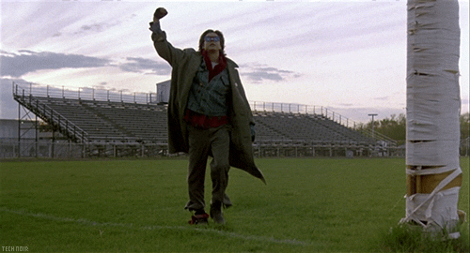
Mr. Brewer you are having too much fun
Mr. Brewer’s
favorite Student.
Teacher ownership of the classroom narrative leads to student buy-in
If the class is your story, your home court, students see you having fun
Use the language that you are interested in in your own life to bring your content even closer to your heart (oh man, cheesy).
Gamification allows teachers to superimpose their own interests ONTO the benchmarks of the Common Core, returning teacher agency and character to the classroom’s daily functions.
All of this leads to engaged students hitting Core Content in their own modalities while instilling a sense of ownership and altruism through cooperation.

