Slide 1
Gamified Classrooms

Slide 2
Goals
Explanation of gamification
Example of classroom games
Working skeletal outline to your own game

Slide 3
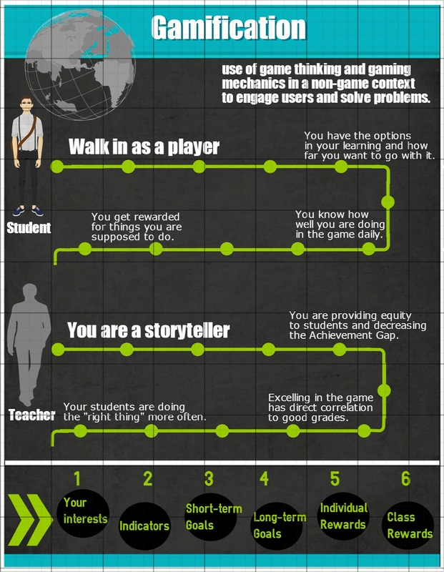
http://lyceumoflouisville.weebly.com/gamification.html
http://prezi.com/qkmdwrfvitro/?utm_campaign=share&utm_medium=copy&rc=ex0share
Notes:
Debbie to present on introduction infographic

Slide 4
Gamification in the classroom
Players
Behavior
Aesthetics
Dynamics
Mechanics
Components
Classrooms
Cost
Outcomes

Slide 5
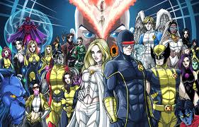
The Mutant Project
Players
Alternative School for misunderstood students
80-85% Free/Reduced
They want a better education and to be accepted

Slide 6
The Mutant Project
Behaviors
Accountability, Engagement, Collaboration, Respect
Poor attendance, disruptive behavior

Slide 7
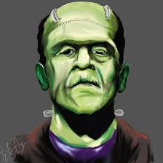
The Mutant Project
Aesthetics
The topic of mutation has always peaked interests, relation to comics “X-men”
Play for playing sake and rewards for encouraged behaviors

Slide 8
The Mutant Project
Dynamics
Hopefully, intrigued…
Rewarded, progression, status, appointment, customization, creativity, altruism

Slide 9
The Mutant Project
Mechanics
You receive an education,
Individual and class rewards, perfect attendance, completing missions, highest mutant class !
blooms taxonomy -
First Class (recall) – vocabulary
United (understand)-online games
Last Stand (apply)-go out to the world, create
days of future past (creation) - read and analyze/create reading

Slide 10
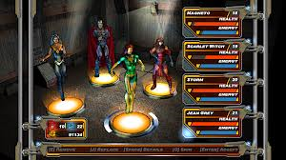
The Mutant Project
Components
Progress bars, leveling up, announcements, rewards, daily feedback on Excel sheet, active participation

Slide 11
The Mutant Project
Classrooms
Physically a large team, but students do small group work often.
Wall space, Excel sheet, JCPS Online, Whiteboard, AB Tutor, Projector, Cloud

Slide 12
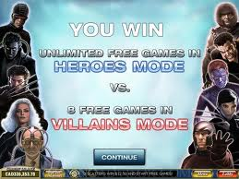
The Mutant Project
Costs
Snacks, soda, cupcakes = tangibles
Very low budget. Each snack/soda <$0.50

Slide 13
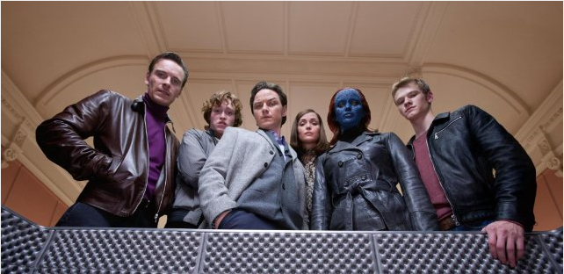
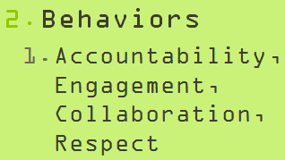
The Mutant Project
Outcomes
Following instructions, accountability, engagement
PowerPoints (PP) and class division awarded. Some categories manage data specifically to behavior (i.e. attendance, strikes, etc)
Accountability, Engagement, Collaboration, Respect

Slide 14
MIKe’s game starts here

Slide 15
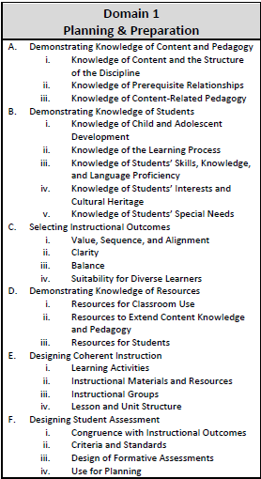
Professional growth and effectiveness system (pges)

Slide 16
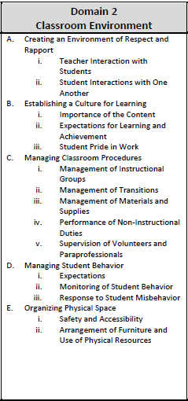
Professional growth and effectiveness system (pges)

Slide 17
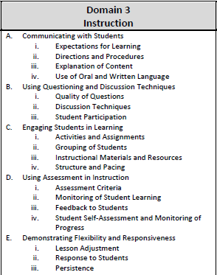
Professional growth and effectiveness system (pges)

Slide 18
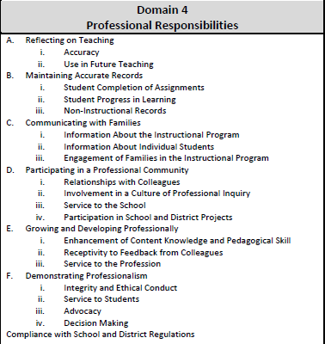
Professional growth and effectiveness system (pges)

Slide 19
Design and discussion (D&D)
Players
Informal
Individually created
Team supported
Creating, Evaluating, Synthesizing…
Team Moderator (Jackie)
Round robin through individual players on main screen
Provide examples for team to reference on main screen
Manage time (each problem must have at least 1 suggestion, but no more than 3 suggestions), approximately 6 minutes devoted to each fundamental
Tech Master (Debbie)
Will circulate around room assisting player needs and provide customized feedback

Slide 20
First, the gathering…
Please turn to your partners, left and right, and shake their hands.
Please introduce yourself by name (first and last), content area (ms science, hs math, 4th grade, etc), and a hobby or interest (sky’s the limit). 20 sec/player
Notes:
Social connection and sense of community

Slide 21
Closing
Direct correlation in doing well in the game and doing well academically!
But, it teaches more than doing well, it teaches the whole learner (respect, accountability, active participants/ citizens, collaboration).
Notes:
Last 5 min of session

