Slide 1
Mutant project

Slide 2
storyline
Students are being trained to become leaders of their own mutant teams. They are required to complete rigorous training before they can initiate a battle to ensure they can stack the odds in their favor!

Slide 3
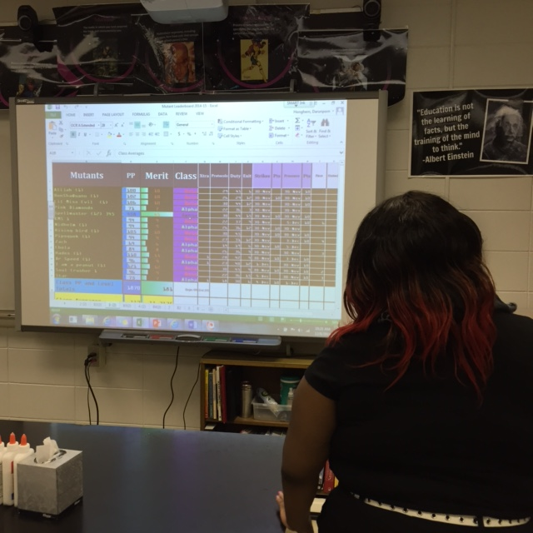
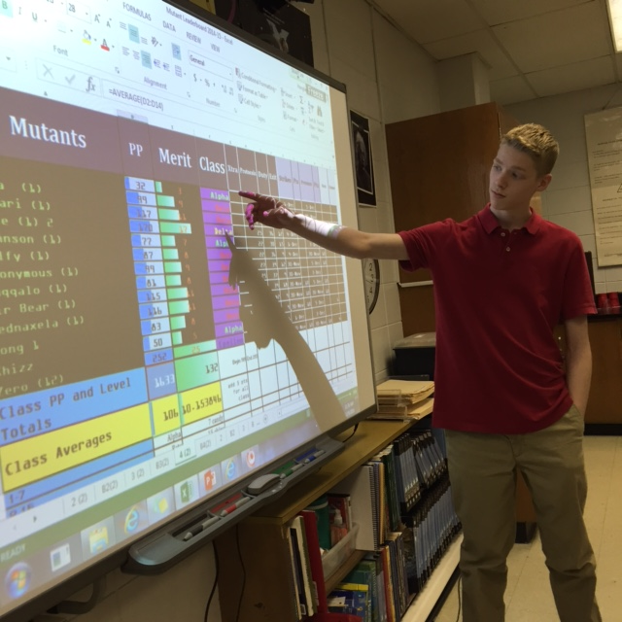
At beginning of class, leaderboard posted

Slide 4
Leveling up
1 P earned · For every question answered thoughtfully in class. 2 P earned · For following all classroom procedures, as they arise. 3 P earned · Complete all daily assignments, as requested by Professor Sharp. 3 P earned · Correctly answering exit slips without assistance. Strikes · Incurred for inappropriate language. · Disrespect of self and others. · Disruption of any sorts.

Slide 5
First class | United | Last Stand | Days of Future Past
1P for every species (plant or animal) found in Peterson Field Guide, provided with scientific name, 1 relative, and why it is or not dangerous to humans. | 2P for every TED Talk video watched and ½ page narrative. Include a paragraph on your opinion of the significance to science. * | 3P for every species collected and identified in Peterson Field Guide (cannot harm species). | 4P for every generated mutant (3 different animals combined) with strengths, weaknesses for each mutant trait, drawing, and correctly created scientific name provided found in Peterson Field Guide.
1P for every pre/suffix defined, provided with 2 examples, and picture drawn/provided for each example of pre/suffix. | 2P for every annotated science article.* | 5P for successfully infected the entire world in online game Pandemic 2.* | 20P for reading “A Walk in the Woods” and writing (3pgs min) a sequel, new ending, or critic review.
1P for every science vocabulary defined, used in sentence, and picture drawn/provided. | 2P for every ACT passage. Benchmark: 90% | 5P for successfully maintaining the family farming business in online game 3rd World Farmer.* | 30P for reading “Ender’s Game” and writing (3pgs min) a sequel, new ending, or critic review.
2P for every vocabulary worksheet. | 4P for every crossword puzzle. | 5P for every taxonomy table created, similar to the one created in class. | 30P for reading “Unwind” and writing (3pgs min) a sequel, new ending, or critic review.
2P for every word search and/or matching worksheet . | 4P for every data representation challenge. Benchmark: 80% | @@@You create a training session. Points rewarded based on level of complexity.@@@ | 50P for reading “The Hunger Games: The Mockingjay” and writing (3pgs min) a sequel, new ending, or critic review.
Recall
Understanding
Application
Creation

Slide 6
Rewards
Individual (competition) by points
Team (collaboration) by dates using class averages
Candy, chips, (tangibles)
Positive referrals, bonus points, PAT (intangibles)

Slide 7
Academically linked

Slide 8
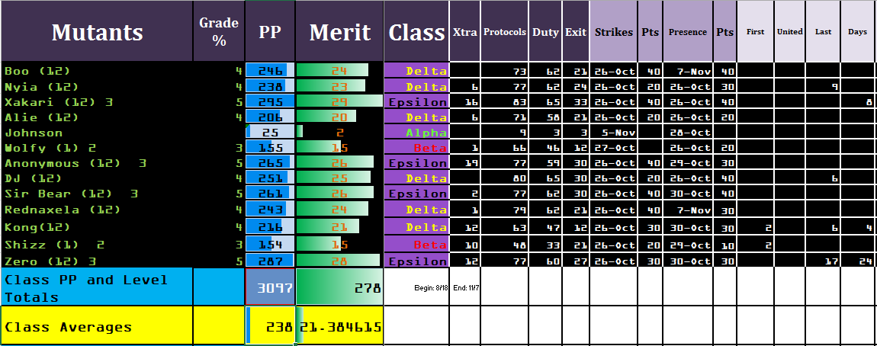
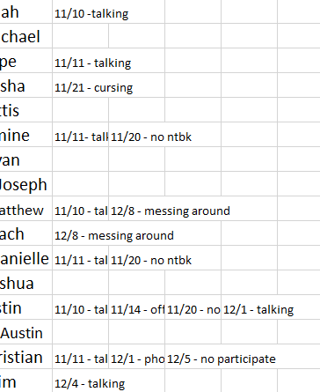

Slide 9
Learned lessons
Visuals and consistent language are important.
Reward students for consistently doing the right thing.
Autonomy adds to the buy-in.
Resetting the game in intervals allows for fresh start for students and changes made by the game keeper.
Excel sheet allows for an array of data collection and management.

Slide 10
Delta (change)
Year 1
Classroom management tool
Year 2
Stream-lined game
Intentionalized gaming components
Aligned optioned activities to Bloom’s Taxonomy
Embed game components in curriculum (Evolution.Protein Synthesis.Ecology)
Year 3
Work on the details, they count the most!

